Slide 1


APPLE STORE PROJECT
Yujie “Carol” Cheng

Slide 2

1
Introduction
2
Preprocessing & EDA
3
Experimental Design
4
Modeling & Result
5
Recommendation

Slide 3



Introduction
Apple Store
Preprocessing & EDA
A/B test
How to increase Apple Store revenue?
The payment method affect the conversion rate.
Design and implement the A/B test.

Slide 4
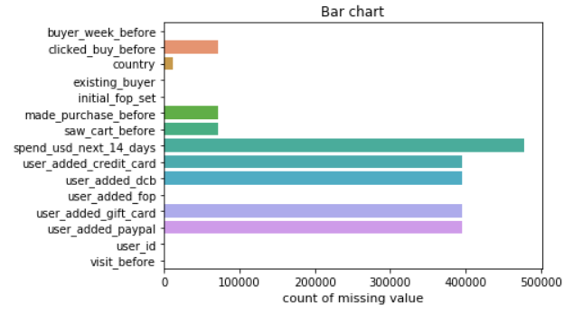
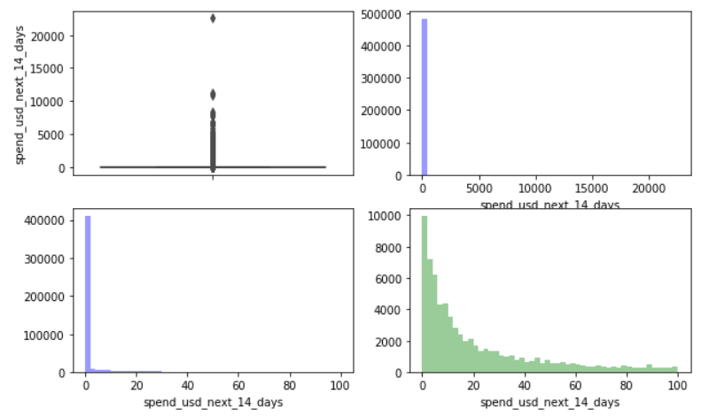
Data Processing
点击添加主要内容
点击添加主要内容
Check Missing Value
Remove Outliers
Fill NA with 0
Users who spend larger than $100 are only 2.7% of total users,.
Remove users who spend larger than $100

Slide 5
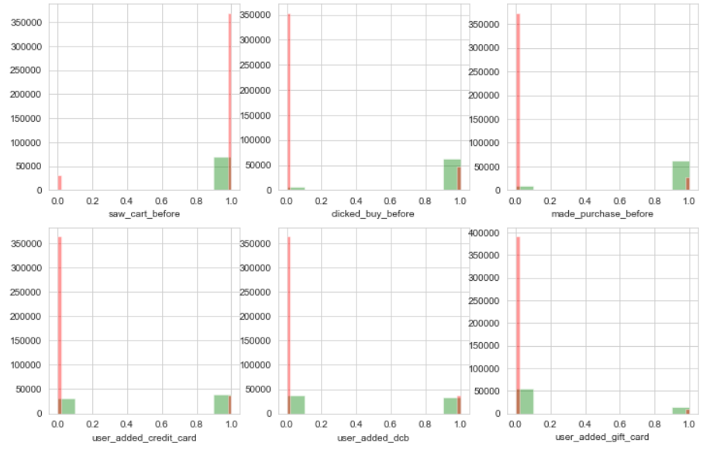
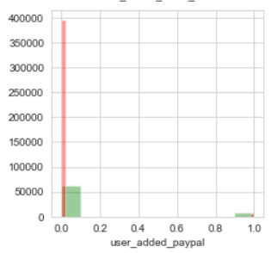
Exploratory Data Analysis

Slide 6
Exploratory Data Analysis
Purchase Funnel
83.11% Visited
77.39% Saw
19.58% Clicked
15.65% Purchased
Total 471005 users

Slide 7
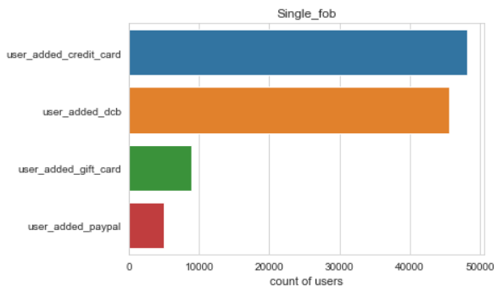
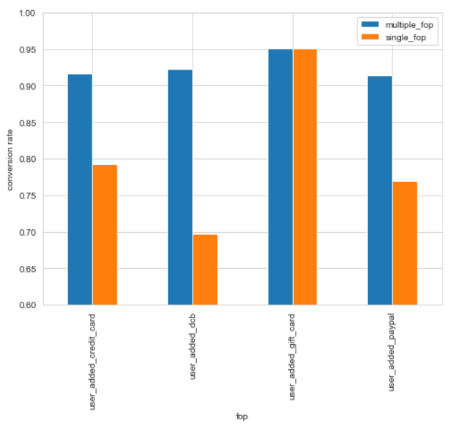
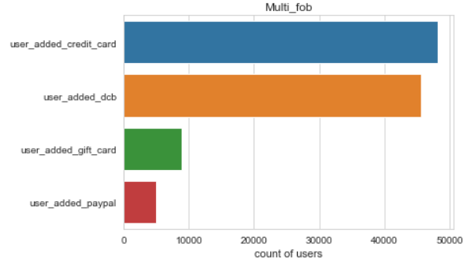
Exploratory Data Analysis

Slide 8
Experimental Design
Lift Rate = 10%
Sig.level = 0.1
Power = 0.9
N >= 20,168
Recommend customer, who only use dcb, add credit card as their payment method.

Slide 9
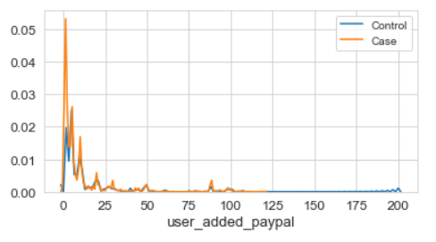
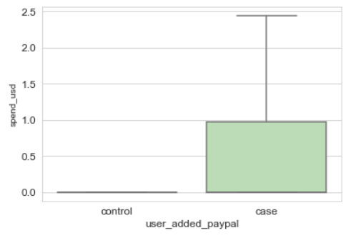
Modeling & Result
T-test Result
N(control) = 24,471 N(case) = 24,695
Statistic = -2.88
P-value = 0.003 < sig.level (0.1)
Lift Rate = (3.1-2.8)/2.8 = 10.71%
Statistically significant

Slide 10
Recommendation
Recommend customer to use credit cards.
Find ways to pursued customer use gift cards.
The cost of any change must smaller than 0.28 dollars per customer.
Take care of when should we end the test and how long will the effect last.

Slide 11
Thanks

